Slide 1
Modular Camera Array for Robotic Arm
Nolan Chandler
MCE 6699

Slide 2
Overall Goals
Modular
Able to be mounted on different machines, not just robotic arm
Low latency
Remote operation via camera stream
Fast image processing
Motion detection
Object detection
Spatial awareness

Slide 3
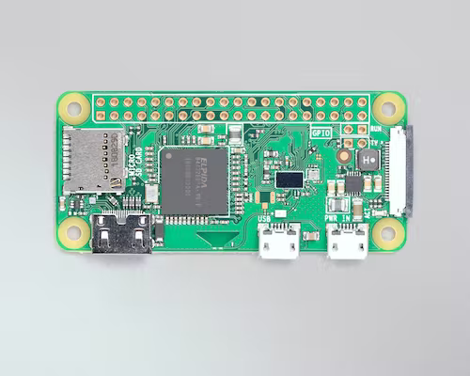
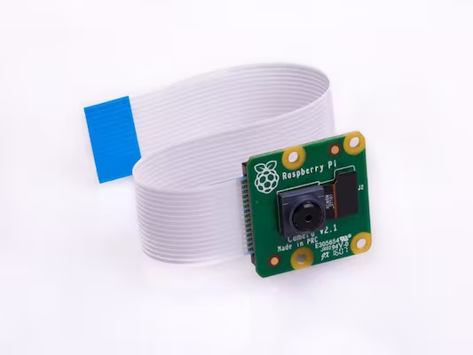
Initial Configuration
Raspberry Pi Zero W
Raspberry Pi Camera Module v2
Readily available
Inexpensive
Small form factor

Slide 4
Configuration Goals
Portable setup
Battery powered
Externally managed
Wireless connection via WiFi/Bluetooth
Determine quality of camera stream
Resolution
Framerate
Latency over different connections

Slide 5
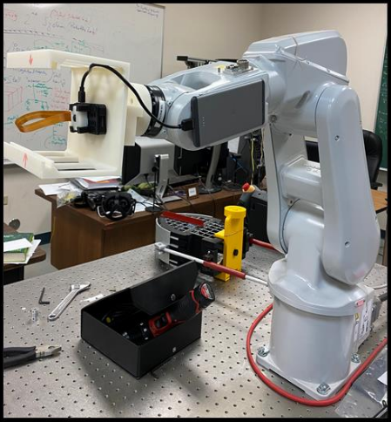
Previous Configuration
Pros
Portable
Long battery life
Small form factor
Simple setup
Cons
MotionEye OS
Optimized for security camera system
Not designed for low-latency streaming

Slide 6
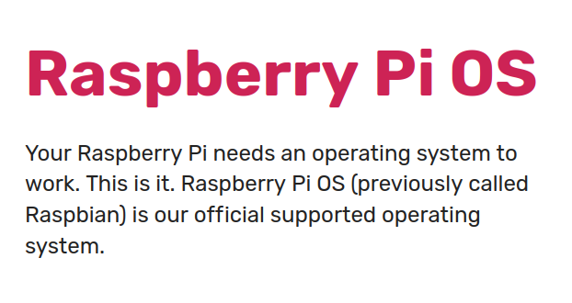
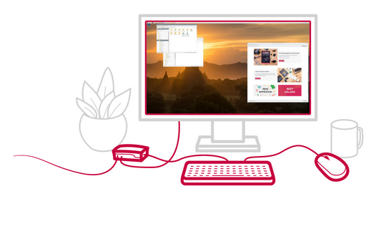
Current Configuration
Standard Raspberry Pi OS
Simple software setup
Well-documented
Easily customizable
Upgradable
Officially supported

Slide 7
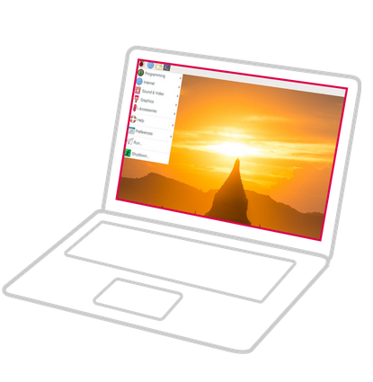
Current Configuration (cont.)
Raspberry Pi OS “Bullseye”
Username: pi
Password: idahostateMCE
Static IPv4 Addresses
10.42.0.1 (on WiFi)
10.43.0.1 (on Bluetooth)

Slide 8
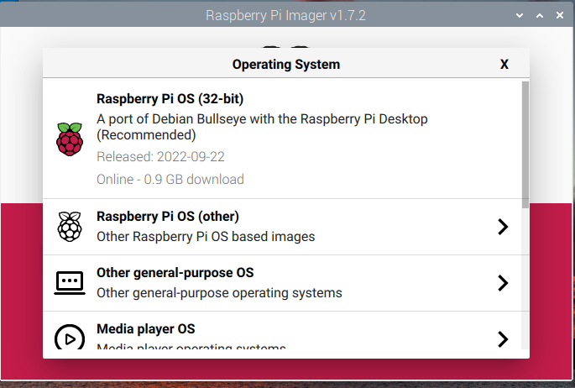
Setup, First Steps
Raspberry Pi Imager
Quick, one-step installation
Downloads and flashes current image to SD card

Slide 9
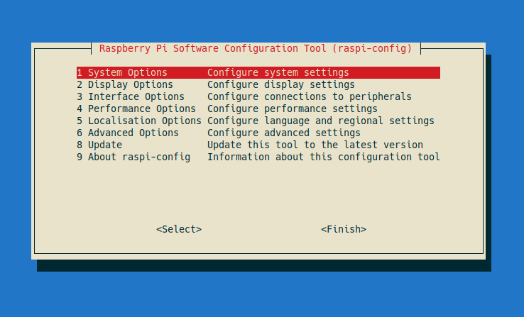
Setup, Customization
raspi-config
Included CLI tool
Access to many Raspberry Pi-specific hardware tweaks

Slide 10
Setup, Customization (cont.)
Change hostname
System options -> S4 Hostname
“robocam-00”
Naming scheme would be used on other Pis in the camera array
robocam-01, 02, etc.
Boot to command line
System options -> S5 Boot/Auto Login
Set “Console Autologin”
Frees up system resources (CPU cycles, RAM)
Desktop session available with `startx`

Slide 11
Setup, Customization (cont.)
Enable SSH Server
Interface Options -> I2 SSH
Allows for remote access to Pi’s command line
ssh pi@robocam-00.local
Enable Glamor
Advanced Options -> A8 Glamor
Hardware accelerated graphics on older Pi models
MUST be enabled for decent camera performance

Slide 12
Setup, Customization (cont.)
Enable NetworkManager
Advanced Options -> AA Network Config
More extensible, flexible interface than previously standard “dhcpd”
New standard; Pi images as of 2022-09-22 have NM enabled by default
Allows for custom network configurations to be imported into system connections directory

Slide 13
Setup, WiFi Host
Pi to be configured as network host over WiFi
Host own SSID, visible to other devices in range
Standardized connection protocol
Laptops, smartphones, WiFi-enabled microcontrollers
Portable
Network travels with Pi
No need for extra hardware to provide wireless connectivity

Slide 14
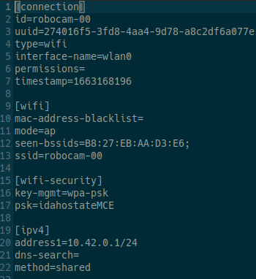
Setup, WiFi Host (cont.)
Setup with included “.nmconnection” file
Parameters can be customized as needed
SSID: robocam-00
PSK: idahostateMCE
Static IP: 10.42.0.1

Slide 15
Setup, WiFi Host (cont.)
Install by moving conf. file to system directory:
Network will be available after next reboot

Slide 16
Setup, Bluetooth PAN
Bluetooth PAN (Personal Area Network)
Allows Pi to host a separate network over Bluetooth protocol
Pros
Less network congestion compared to 2.4 GHz WiFi with more available channels
Cons
Less available bandwidth; slower data transfer
More latency
Complicated setup; requires pairing via other interface

Slide 17
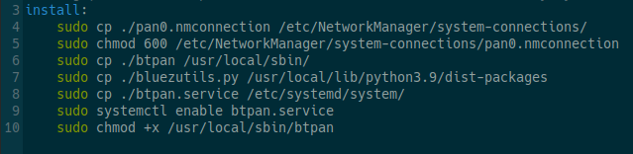
Setup, Bluetooth PAN (cont.)
Included files contain all configuration details
Network bridge, BT daemon, systemd service
Network available after reboot

Slide 18
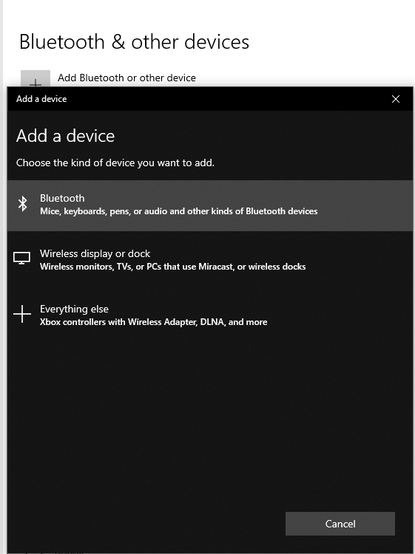
Setup, Bluetooth PAN (cont.)
Pairing
Any device to use the Bluetooth connection must be previously paired
One-time process
Varies immensely across different client devices

Slide 19
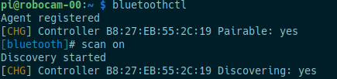
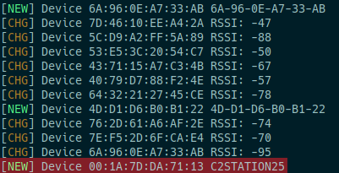
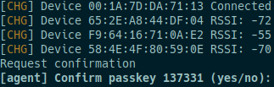
Setup, Bluetooth PAN (cont.)
bluetoothctl
CLI to scan for and pair with client devices
Scan, watch for desired client
Initiate pairing handshake

Slide 20
Setup, USB Ethernet
Alternate connection providing internet access to Raspberry Pi as client for software installation/upgrade
Direct wired connection using USB A -> USB Micro cable
Accessible without altering/disabling other connection interfaces (WiFi, Bluetooth)

Slide 21
Setup, USB Ethernet (cont.)
Connection configuration included
Requires altering 3 system configuration files on Pi
/boot/config.txt
/boot/cmdline.txt
/etc/rc.local
Requires setup on host machine
DHCP server
IP forwarding
Masquerading rules
Very simple to do on both Windows and Linux hosts!

Slide 22
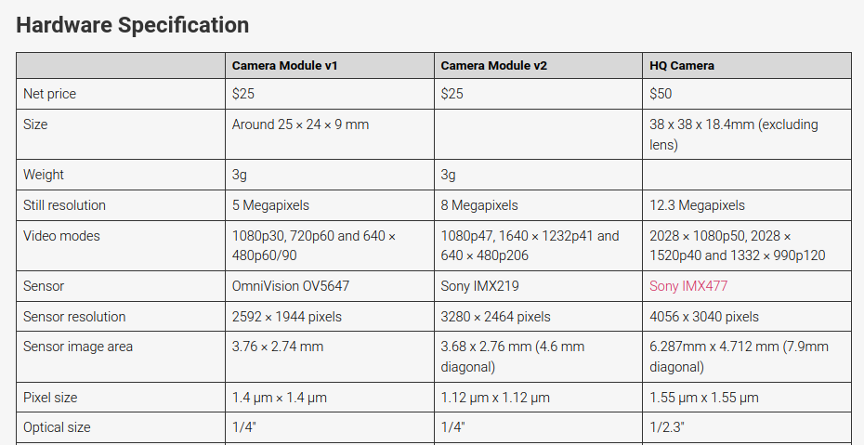
Camera setup
Included Raspberry Pi camera library, libcamera
New camera stack; under heavy development
Easy to install (likely already included)
$ sudo apt install libcamera-apps

Slide 23
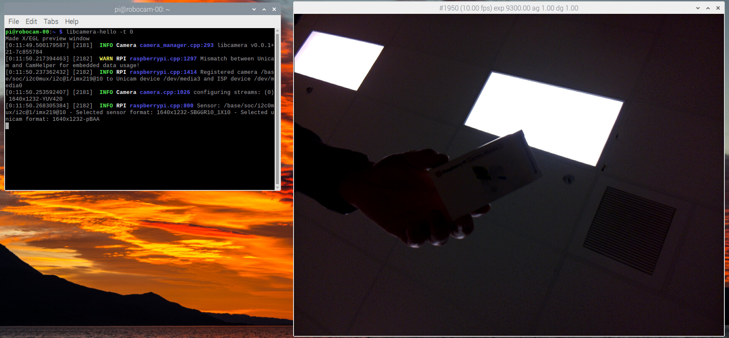
Camera setup (cont.)
Installation can be checked with included demo app
$ libcamera-hello

Slide 24
Camera setup, Python
libcamera built to easily interface with user-friendly Python API via picamera2
$ sudo apt install python3-picamera2
Raspberry Pi’s official Python library
Well-documented and backward compatible
Many easily available examples and demos

Slide 25
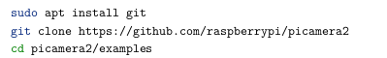
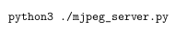
Web Server Camera Stream
picamera2 has a demo for a simple HTTP server with embedded camera stream
HTTP supported on any device with a web browser
Available to any device on Pi’s networks; WiFi, Bluetooth, Ethernet
Similar to what would be used for remote operation of robot
Download examples and run:

Slide 26
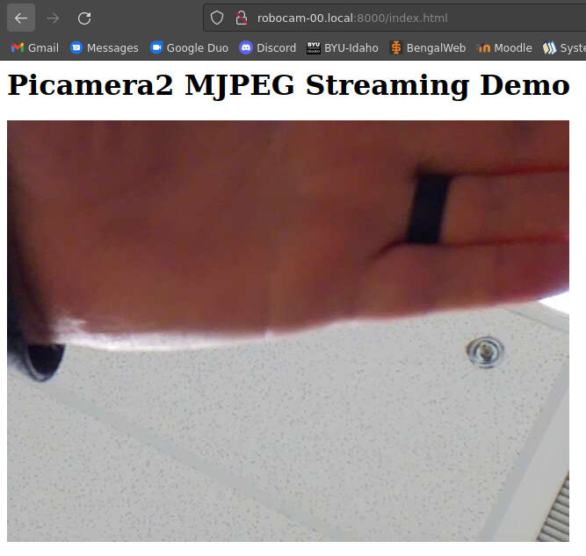
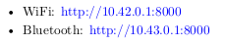
Web Server Camera Stream (cont.)
On client device, open URL

Slide 27
Observations and results
Pi Zero W
Low power, low performance
Locally displayed camera stream struggled to update faster than 10 frames per second
Effect compounds with network latency, most noticeably over Bluetooth network
Unacceptable for goal use cases where image processing must be done quickly with low latency

Slide 28
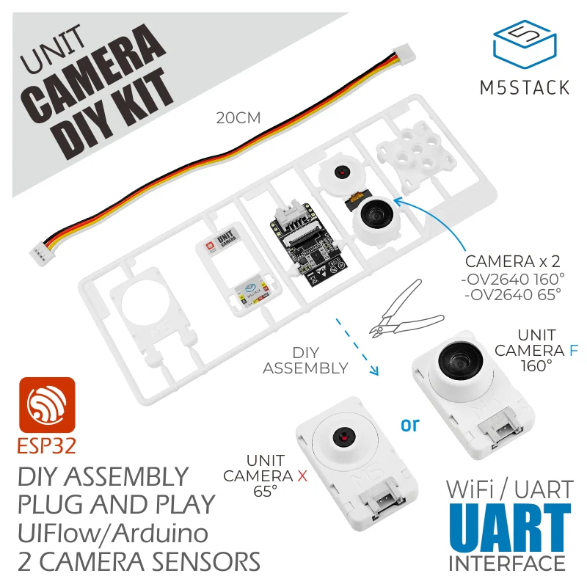
Hardware considerations
M5Stack ESP32 WiFi camera
Fish-eye lens camera included
Battery powered
Small form factor
Pros
Small, modular
Host board resources freed
Cons
Requires host board to process images

Slide 29
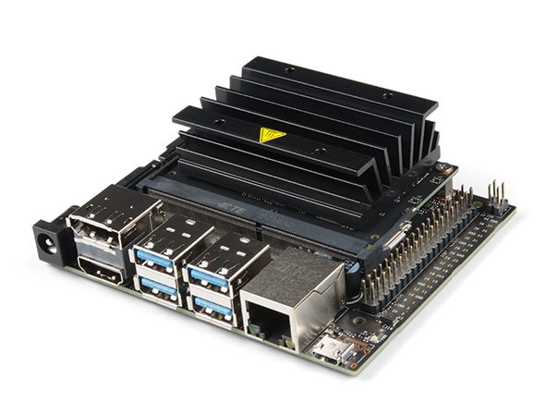
Hardware considerations (cont.)
NVIDIA Jetson Nano 4GB
Small, affordable board built for low scale AI/image processing
Pros
2 MIPI CSI camera ports with 12 MIPI camera lanes
Low power consumption
Cons
Currently unavailable

Slide 30
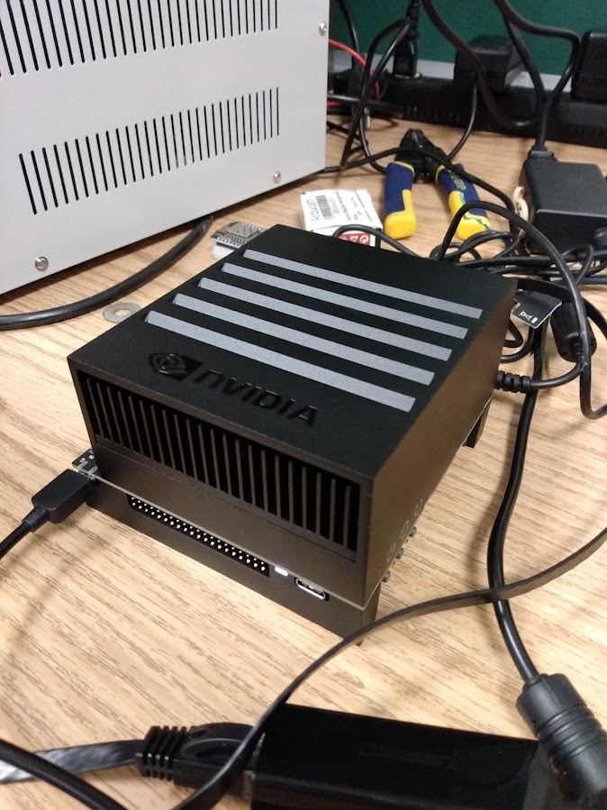
Hardware considerations (cont.)
NVIDIA AGX Xavier
Board built for extreme AI/image processing
Pros
16 MIPI camera lanes, up to 6 cameras simultaneously
We already have one!
Cons
Non-standard camera ports, kit with breakout board required

Slide 31
NVIDIA Xavier Setup
OS flashing and setup requires external computer
As of writing, only Ubuntu 20.04 LTS supported by NVIDIA
Create account on NVIDIA Developer website
https://developer.nvidia.com
Find and download NVIDIA SDKManager tool
https://developer.nvidia.com/drive/sdk-manager
Install deb package on host machine
$ sudo apt install ./sdkmanager.deb

Slide 32
NVIDIA Xavier Setup (cont.)
Connect power to NVIDIA board
Connect HDMI display and keyboard/mouse to rear I/O ports
Connect front USB-C port to host computer using included USB-C -> USB-A 3.0 cable
Put NVIDIA board into Recovery mode for flashing
While holding recovery button, press and hold power button

Slide 33
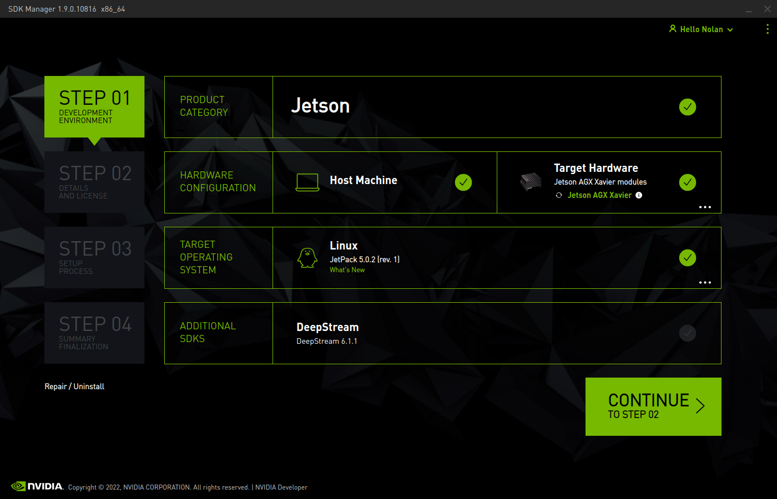
NVIDIA Xavier Setup (cont.)
Start NVIDIA SDK Manager on host machine
Login with Developer account
Jetson AGX board will be automatically discovered

Slide 34
NVIDIA Xavier Setup (cont.)
Click Continue
SDK Manager will download and flash OS and selected SDK components to NVIDIA board
On-screen prompts are given throughout the installation process
Initial setup is then done on the NVIDIA board using the connected display and keyboard/mouse

Slide 35
NVIDIA Xavier Current Conf.
Hostname: agx-xavier
Username: jetson
Password: idahostateMCE
Jetson OS is based on ARM64 Ubuntu
Ubuntu version CANNOT be upgraded via Ubuntu Software Updater; this will break the system
Disabled by default

Slide 36
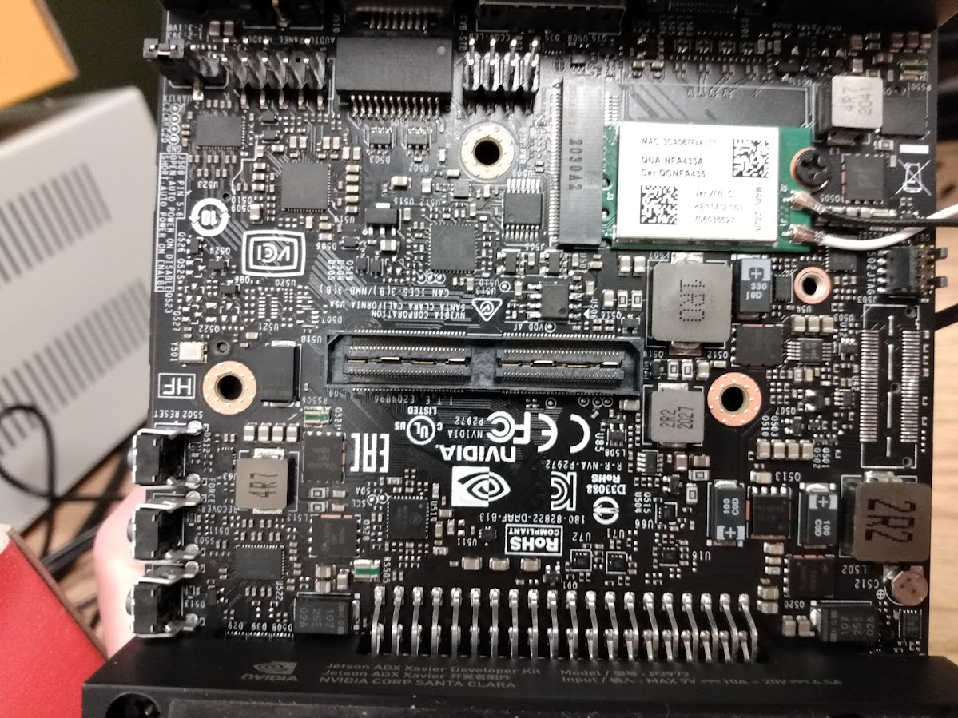
Future Considerations
AGX Xavier has non-standard camera ports
Obtain and test camera breakout board and kit

Slide 37
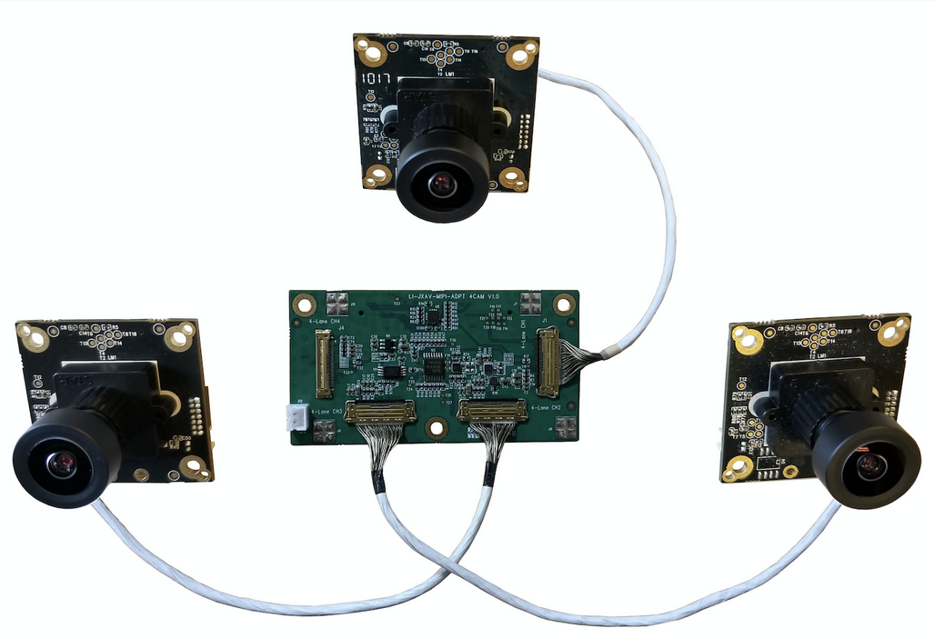
Future Considerations (cont.)
Kits available from Leopard Imaging in the $1500-$2000 range
Breakout board and cameras (1-6) included
https://www.leopardimaging.com/product/nvidia-jetson-cameras/nvidia-agx-xavier-camera-kits/li-xavier-kit-imx264-x/li-xavier-kit-imx264m12-t/

Slide 38
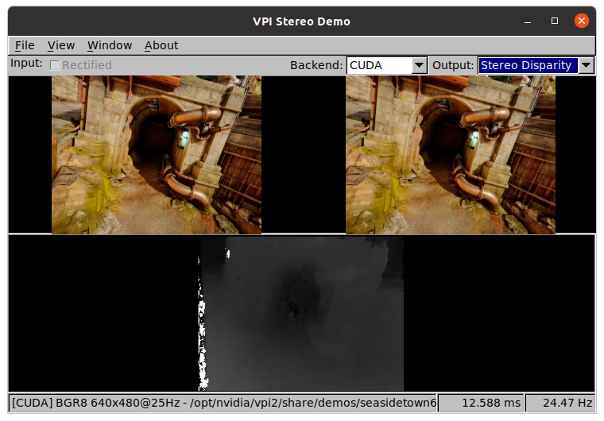
Future Considerations (cont.)
Several examples are included in the flashed OS for image processing using NVIDIA hardware
Find relevant examples and build from there

